Slide 1
Premier League
The Premier League is composed of 20 teams
Manages the competition and matches between teams
Sponsorships, broadcast fees and matches
Matches being played are crucial for the generation of revenue
Data needs to be about teams, their players and matches
You can find info about the matches played, the teams that will be relegated, the performance of players

Slide 2
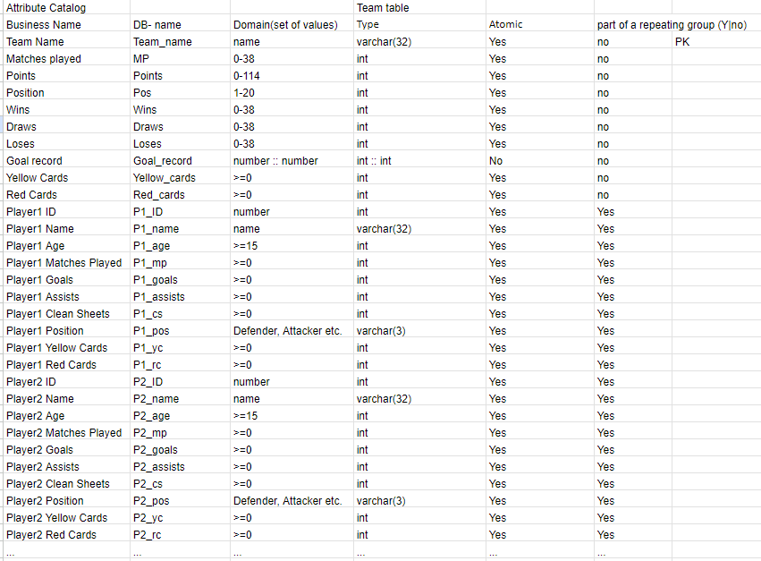
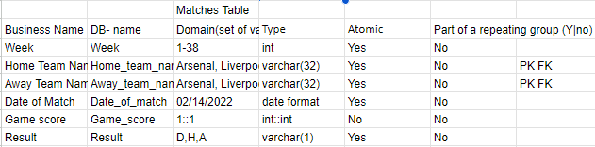
Attribute Catalog

Slide 3
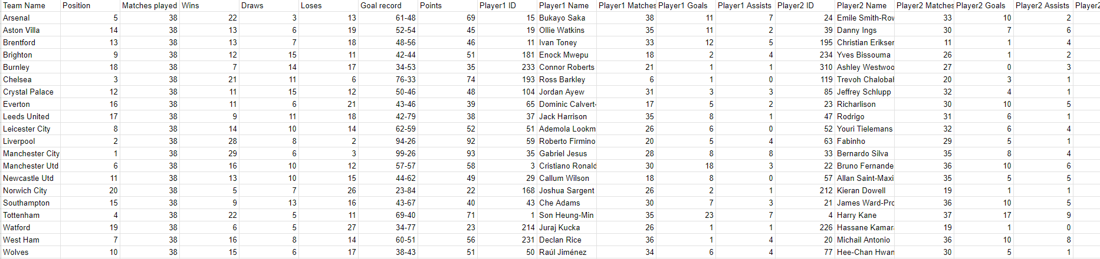
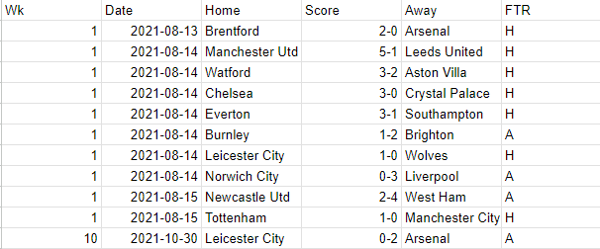
Raw Files
Inadequate information about teams and players
Matches Table

Slide 4


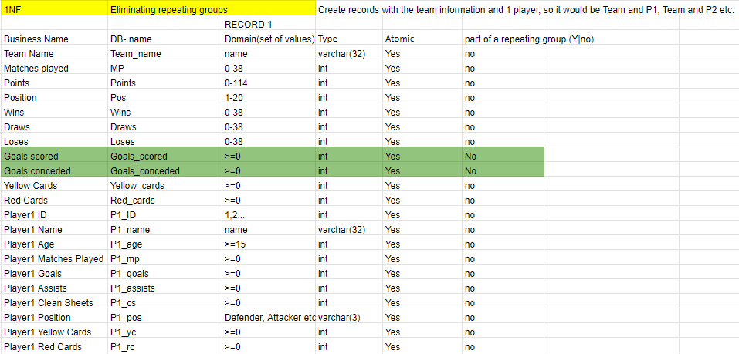
First Normal Form
Matches Table
1NF Creating Primary Key
Teams Table: PK(Team Name, Player ID)
Matches Table: PK (Home Team Name, Away Team Name)

Slide 5
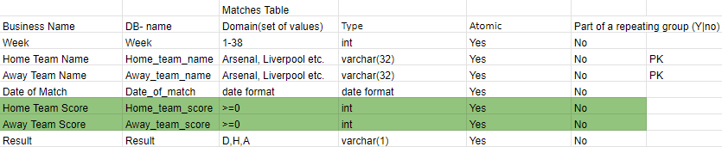
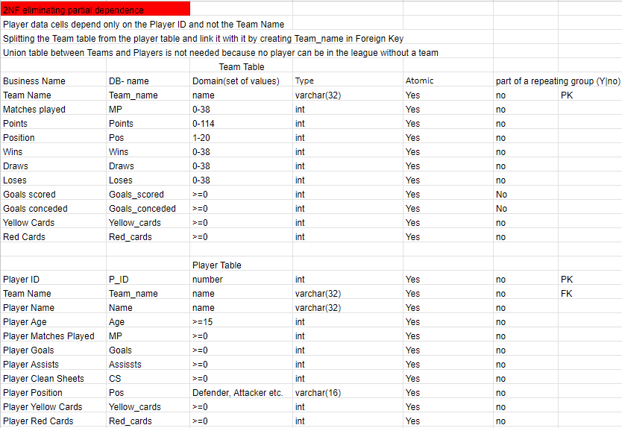
Second Normal Form
Matches Table is already in the Second Normal Form.
All non key attributes depend on both fields of the primary key.

Slide 6
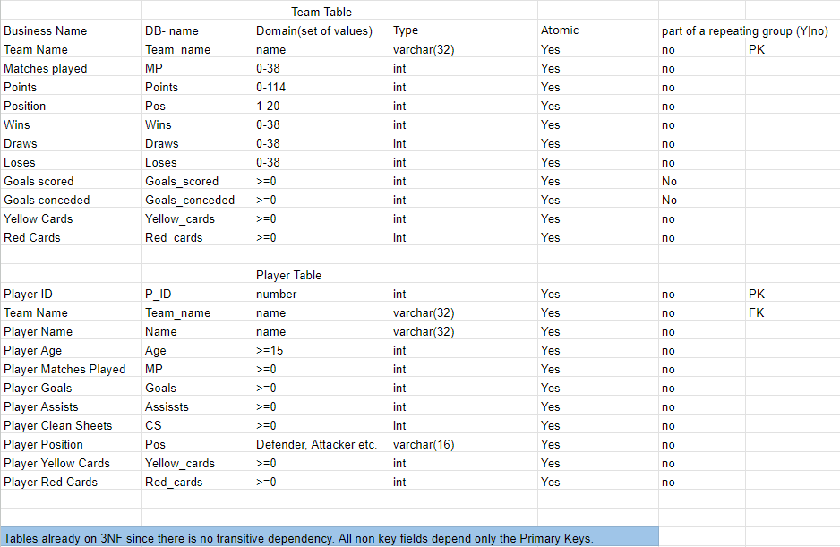

Third Normal Form
The tables are already in third normal form. No transitive dependence exists. All non key attributes depend only on the key attribute.
All information provided by the non key attributes is specific to the team, player or match (which are used as PKs). Thus, no non PK attribute depends on other non PK attributes.

Slide 7
Data Definition Language
Data Manipulation Language
Create table Teams( Team_name varchar(64),Pos int, MP int, Wins int, Draws int, Loses int, Goals_scored int, Goals_conceded int, Points int); The Yellow_cards and Red_cards will be added after the data is inserted in the table.
Create table Matches( Week int, Date Date, Home_team varchar(64), Home_team_score int, Away_team_score int, Away_team varchar(64), Result varchar(1));
Create table Players(PID int, Name varchar(64), Age int, Team_name varchar(64), MP int, Goals int, Assists int, Yellow_cards int, Red_cards int); Position and Clean Sheets will be added after the data is inserted.
Alter table Teams Add Yellow_cards int, Red_cards int; //Adding the columns to the teams, NULL for all teams
Update Teams Set Yellow_cards = __, Red_cards = __ where Team_name = __; //Updating every teams cards
Alter table Players Add Pos varchar(16), CS int; //Adding the columns to the players, NULL for all players;
Update Players Set Pos = __ where Name = __; //Updating the position of every player;
Update Players Set CS = 0; //Put 0 for all players
Update Players Set CS = __ where Name = __ (gk name); //Update just goalkeepers

Slide 8
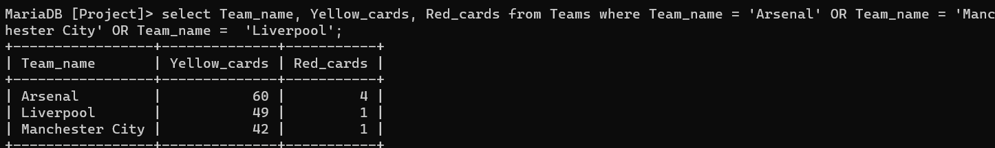
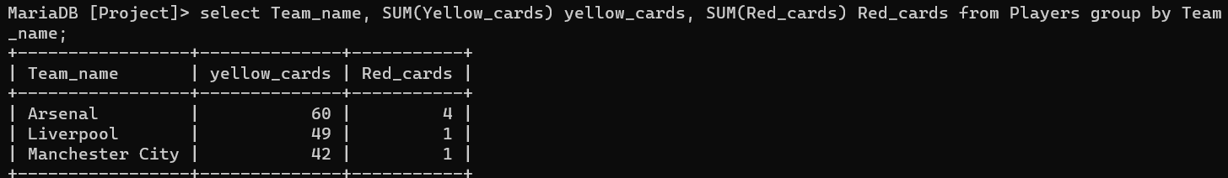
Some Queries

Slide 9
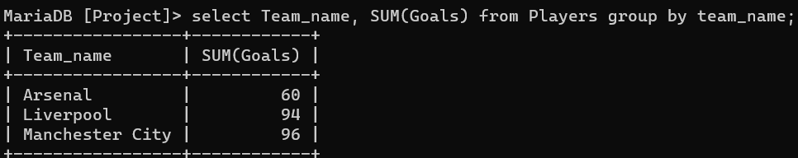
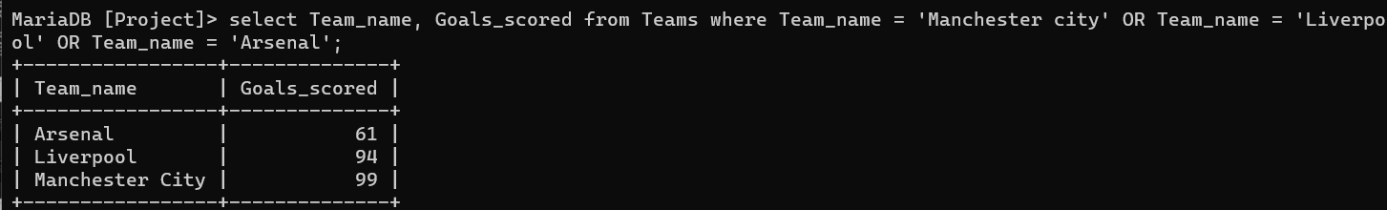
More Queries

Slide 10
